Slide 1
VHDL project
GROUP 18
Problem Statement:
Design an 8 bit floating point ALU that supports the arithmetic and logic operations: addition, subtraction, multiplication, division, AND, OR, NOT, XOR on floating point numbers.

Slide 2
IDEA
The basic idea of the project was to perform different operations on two 8 bit floating point numbers. To achieve the same VHDL was used along with Xilinx ISE software. Program has 19 inputs and 8 outputs.

Slide 3
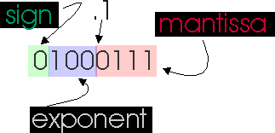
inputs
There are total of 19 inputs
Each input is taken in 8 bit IEEE 754 format as shown in the picture below
In each input of 8 bit, the first bit represents sign bit and next three bits represented the exponent and next four bits represented the mantissa.
Three input for the 7 kind of operations to be performed 000 SUM 011 AND 001 DIF 100 OR 010 PRO 101 XOR 110 NOT

Slide 4
output
There are total of 9 output PINS
Eight output for result in the form s[7] s[6] s[5] s[4] s[3] s[2] s[1] s[0]
One output to mention whether the result of operation is in bounds or not.

Slide 5
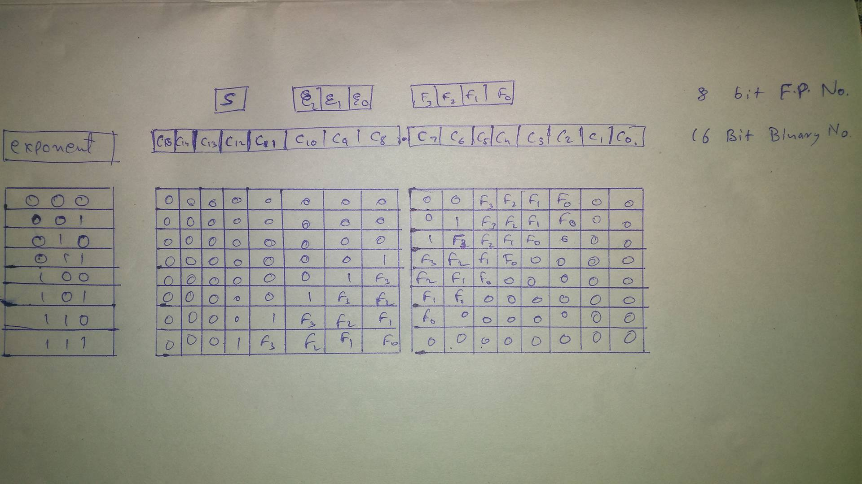
Chart for converting 8 bit ieee to binary

Slide 6
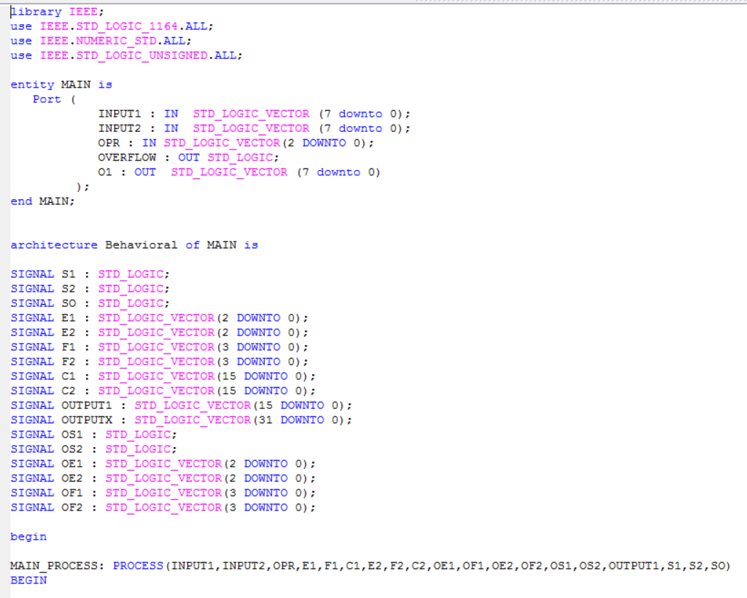
CODE

Slide 7
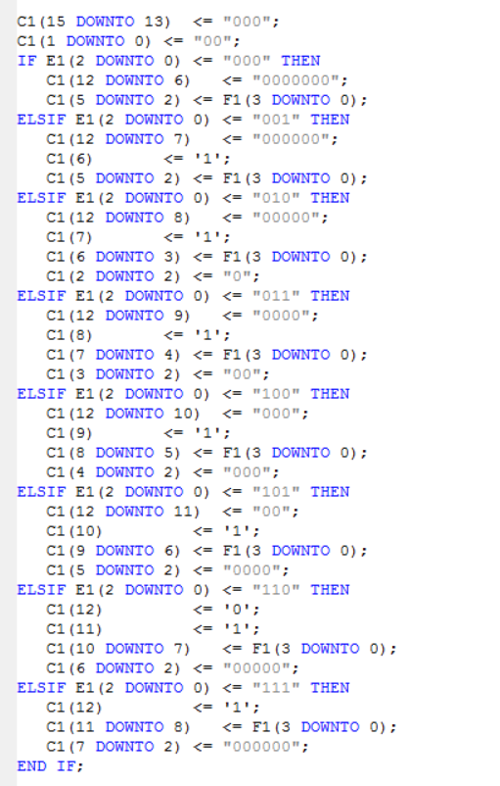
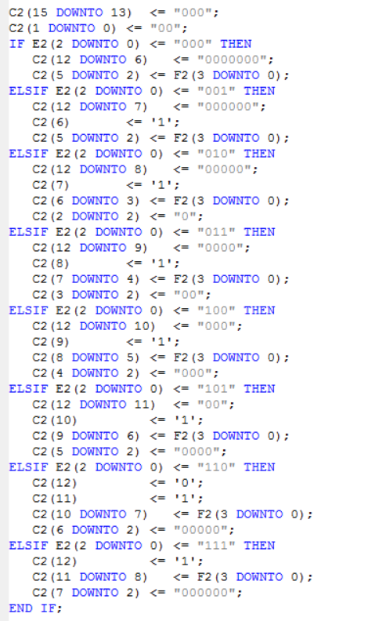
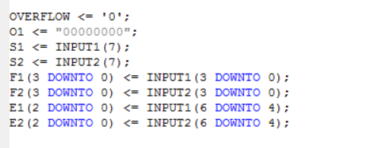
INITIALISATION AND CONVERSION OF FLOATING POINT NO. INTO 16 BIT BINARY NO.

Slide 8
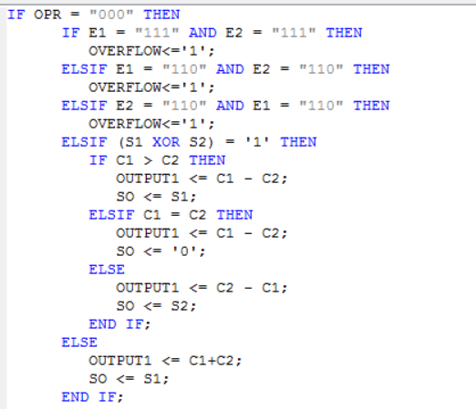
Code for VARIOUS OPERATIONS
ADDITION

Slide 9
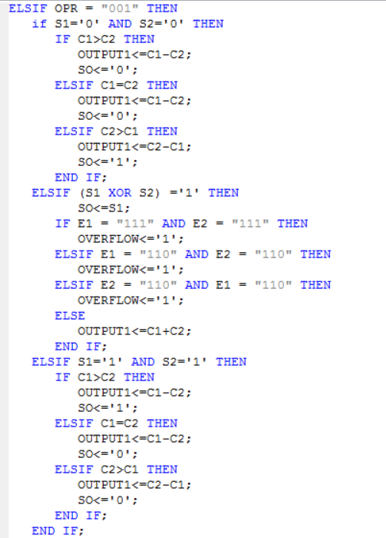
SUBTRACTION

Slide 10
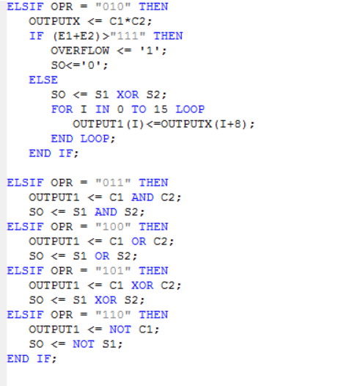
MULTIPLICATION
AND
OR
XOR
NOT (first input)

Slide 11
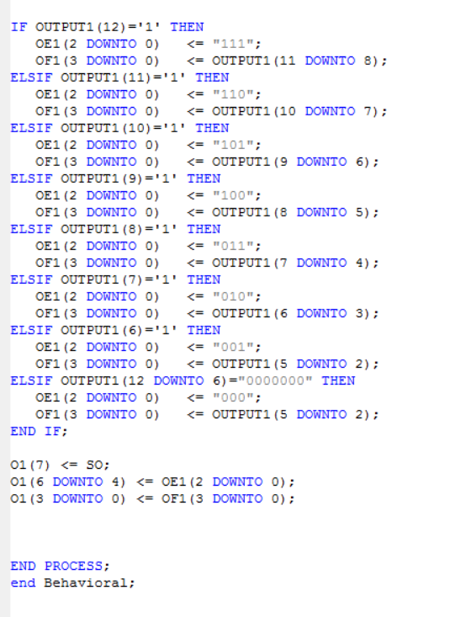
CONVERSION OF 16 BIT BINARY NO. INTO 8 BIT IEEE format for floating point number

Slide 12
Compilation report

Slide 13
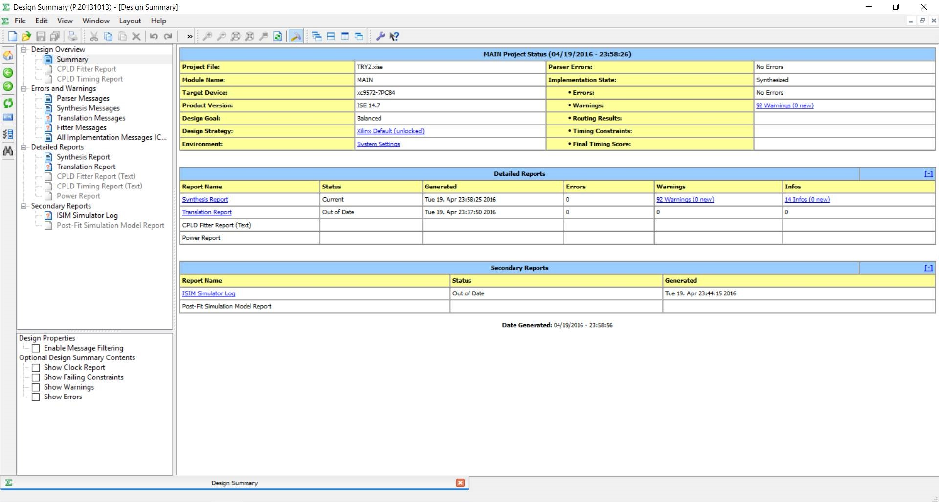

Slide 14
Simulation report

Slide 15
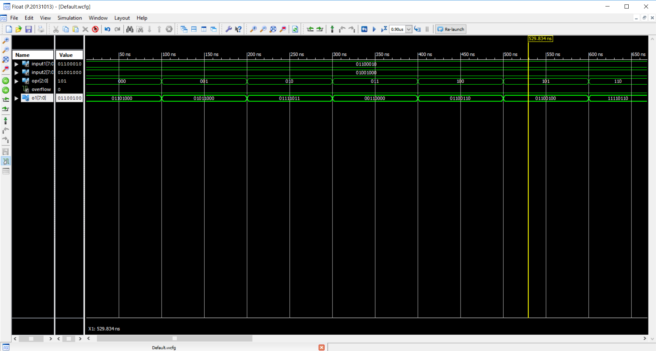
Two positive number inputs

Slide 16
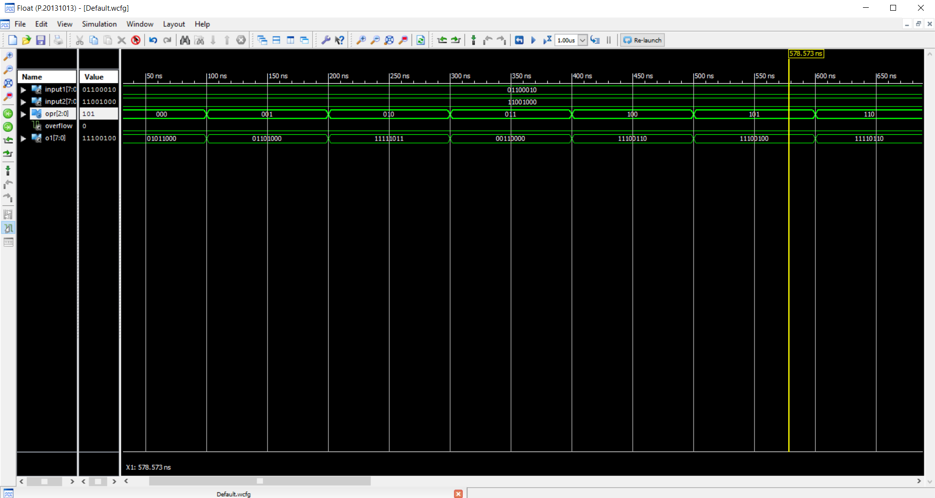
positive and negative number input

Slide 17
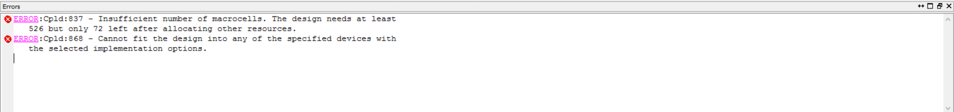
Error in fitting
Initial code submitted and implemented had operations on input and output of binary numbers. The present code which includes input and output of 8 bit floating point numbers is well stimulated. But, due to requirement of large macrocells our code is not possible to be implemented on the CPLD board provided to us.

Slide 18
Project and Presentation by Group 18:
Anuj Dahiya 15114015
Kanishk Goyal 15114035
Siraz Shaikh 15114065
Abhishek Sajwan 15114002
Aman Agarwal 15114006
Sahil Grover 15114061

